Slide 1
Topic 3 : Web Analytics for Site Optimization
ST2228 Web and Mobile Analytics

Slide 2
Learning Objectives
Describe Segmentation of Data
Explain Visitor Value over Time
Interpret Results from Visitor Activity Analysis
Interpret the Results from Navigation and Site Analysis
Apply Content Analysis
Apply Conversion Optimization
Content Experiments
Voice of Customer

Slide 3
Major groupings of Google Analytics reports
Audience
Acquisition
Behavior
CONVersions

Slide 4
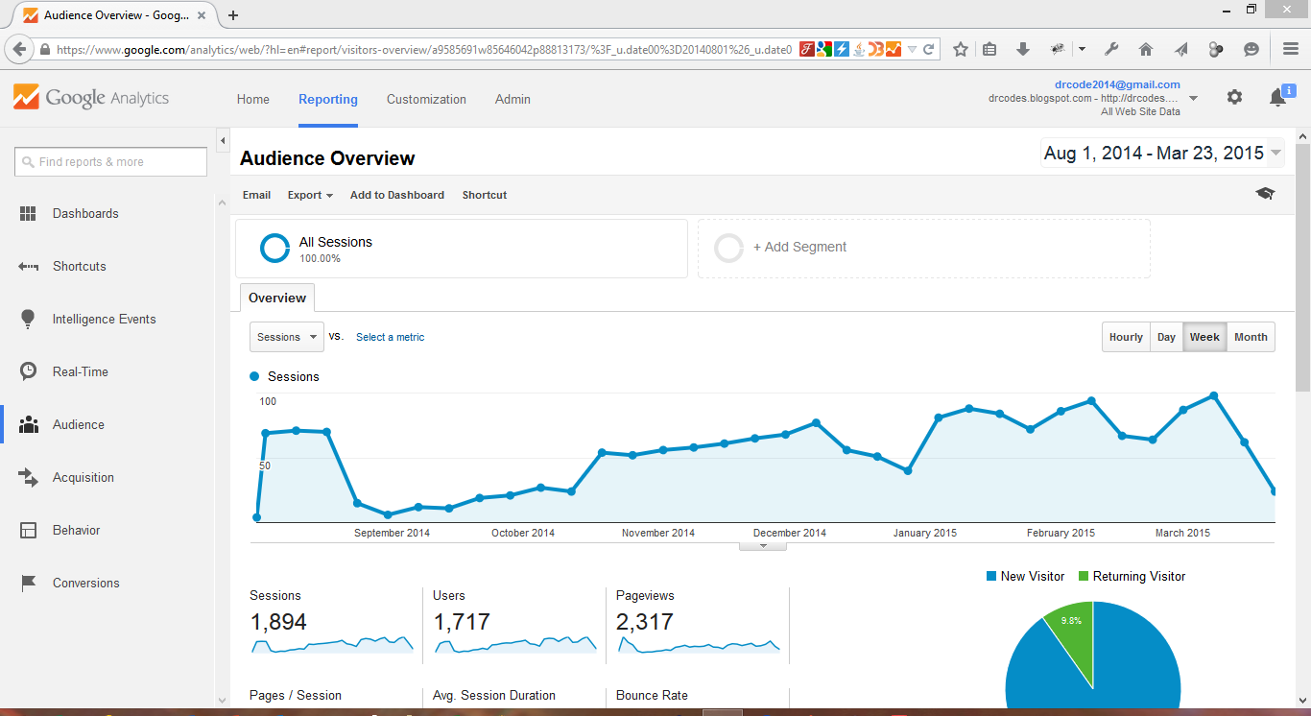

Slide 5
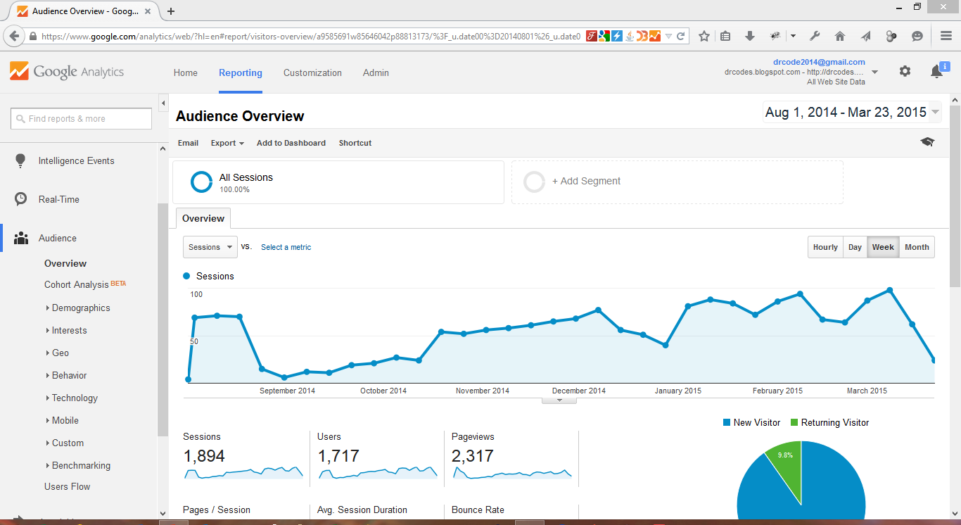

Slide 6
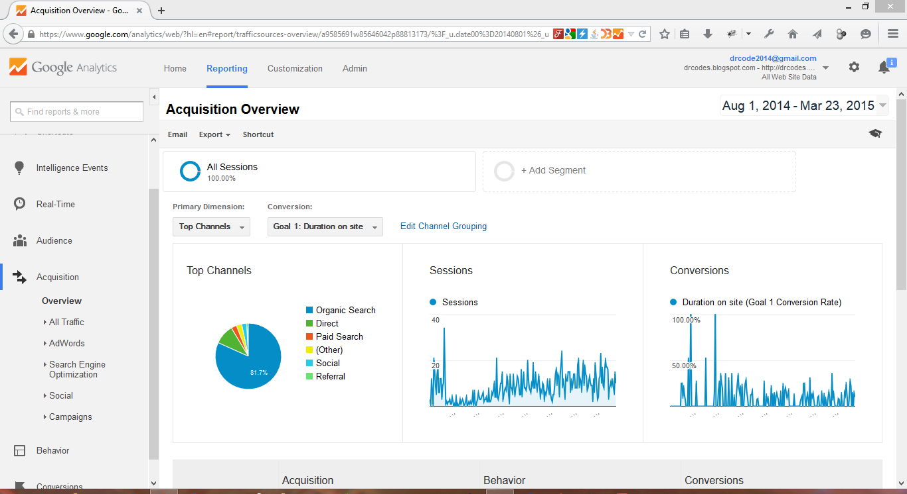

Slide 7
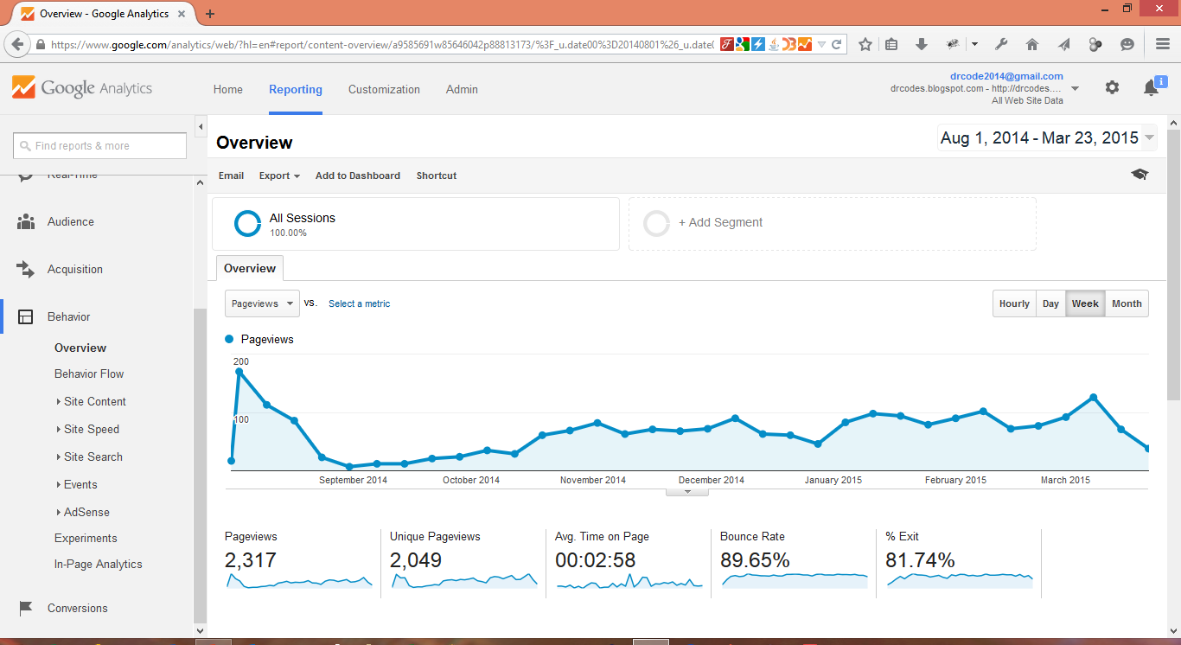

Slide 8
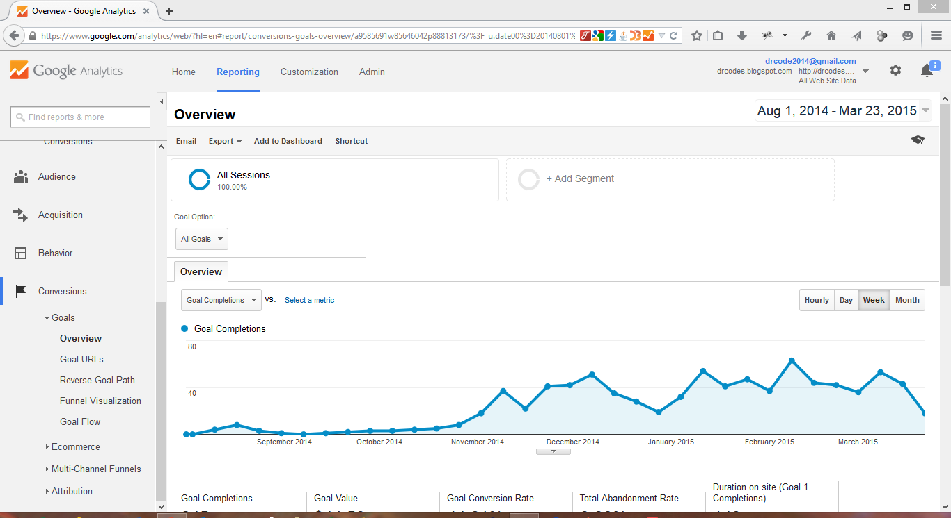

Slide 9
Content Analysis
Analysing How People Use Your Content

Slide 10

Content analysis

Slide 11
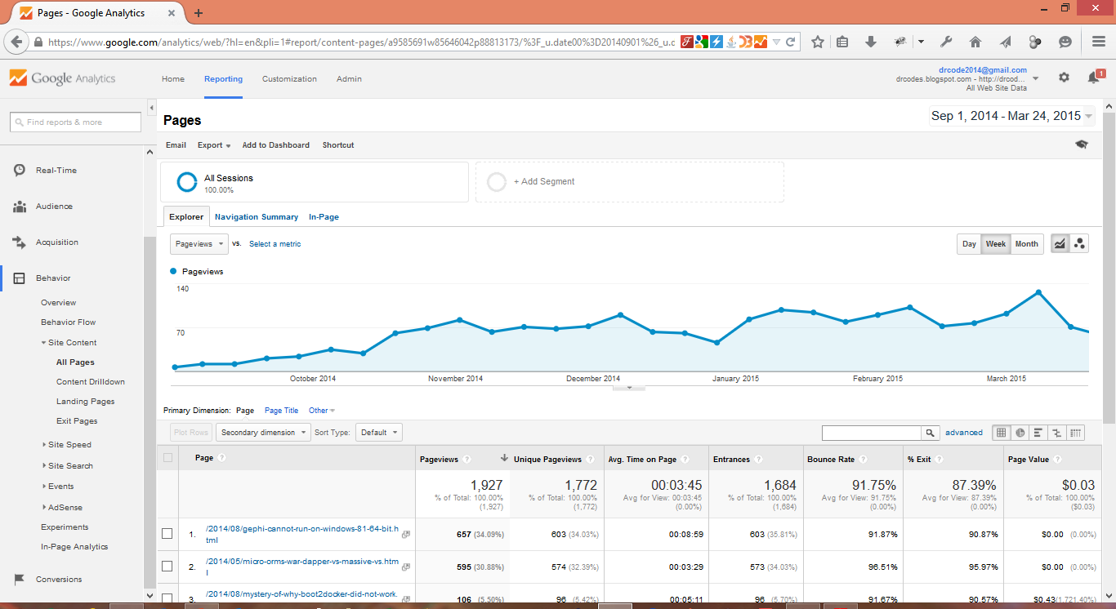
All pages report — the goto place for content analysis

Slide 12
Why Content Analysis?
Content Analysis will give you insights into how users interact with the pages on your website.
Where do your visitors go?
How long do they stay there?
What pages people enter your website on?
From which pages do they exit your website?

Slide 13
Why Content Analysis?
It can confirm your assumptions, and enables you to see how changes to your website affect users’ behavior.
The Behavior Reports in Google provide a practical framework for digging into metrics such as
Bounce rate,
Time on page,
Pageviews, etc.

Slide 14
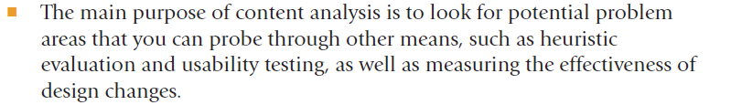
Purpose

Slide 15

What to look for in page usage metrics

Slide 16
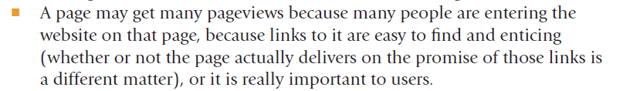
High pageviews

Slide 17
Low pageviews

Slide 18
High Pageview/Unique Pageview ratio

Slide 19
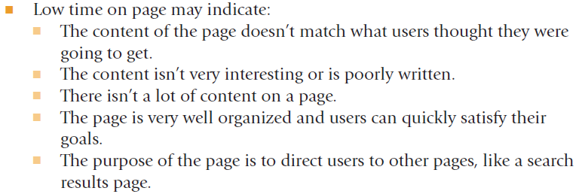
Low time on page

Slide 20
High time on page

Slide 21
High bounce rate

Slide 22
High % exit

Slide 23
Page value

Slide 24

Comparing pages

Slide 25
Click-Path Analysis
Visitors’ FlOW

Slide 26
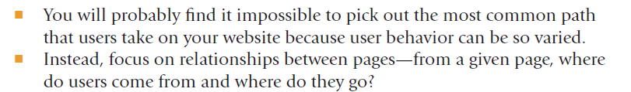

Slide 27
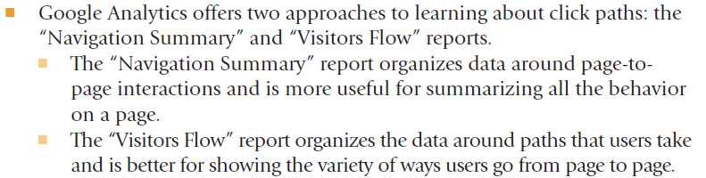

Slide 28
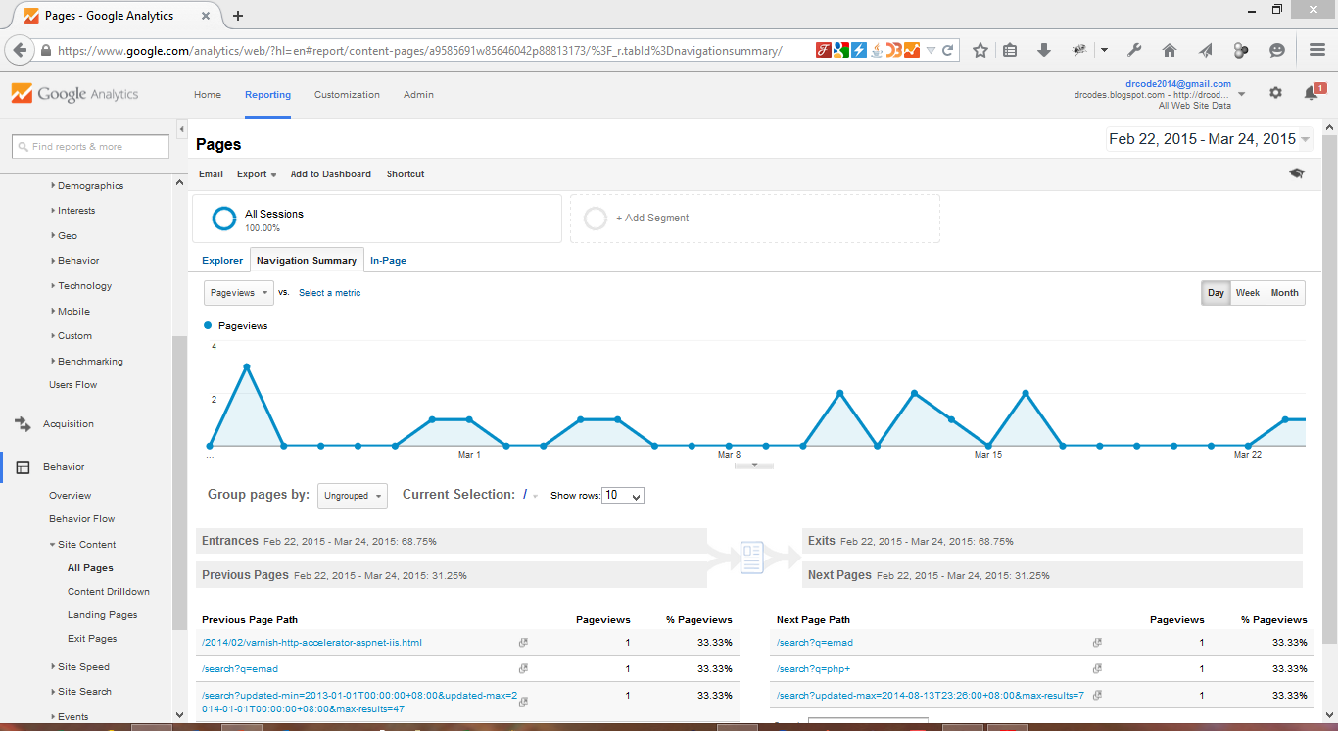
All Pages — Navigation Summary

Slide 29
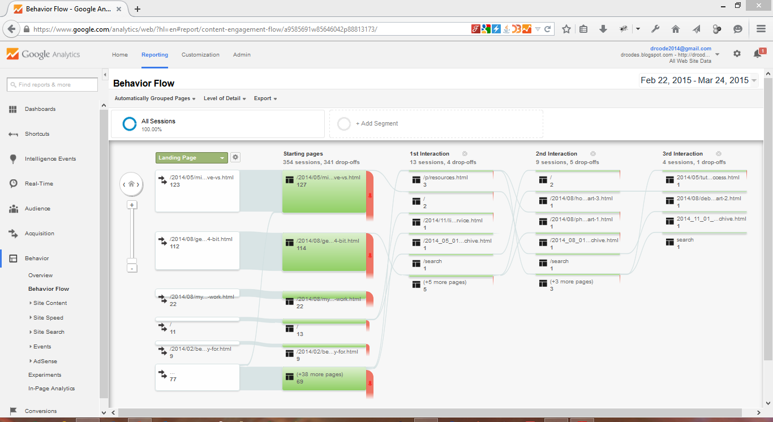
Behavior Flow/ Visitor Flow report

Slide 30
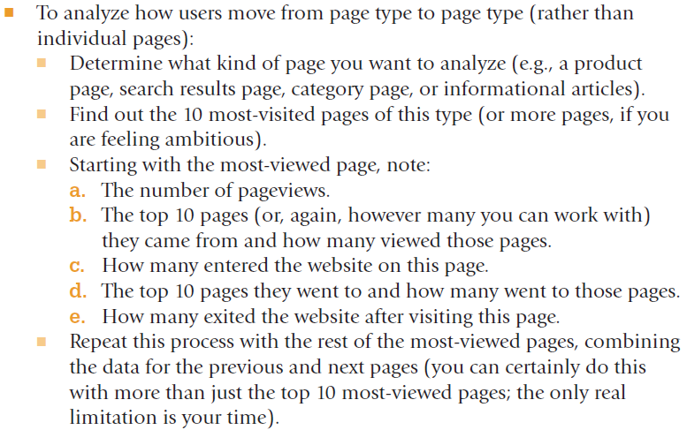
Process

Slide 31
Segmentation

Slide 32
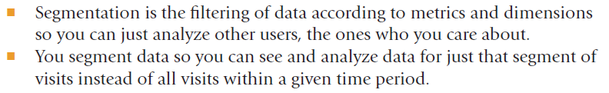
Why segment?

Slide 33
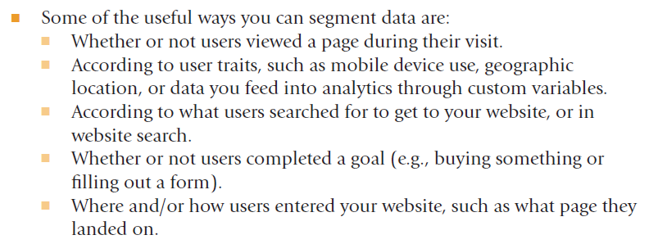
How to segment?

Slide 34
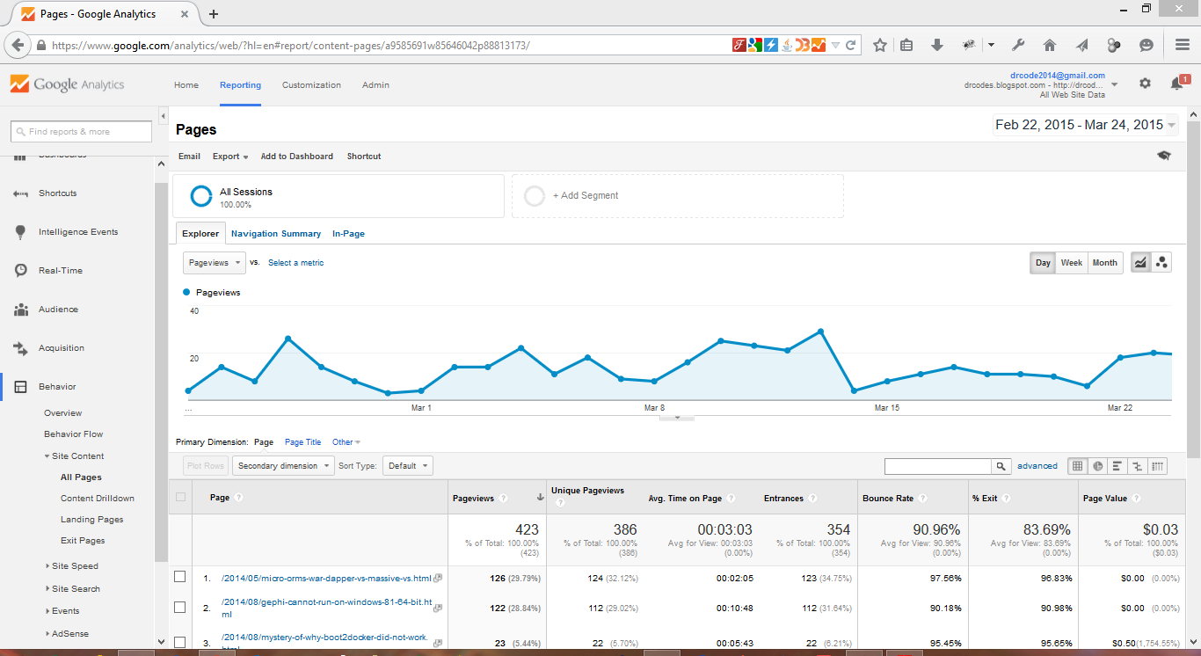
To add a new segment

Slide 35
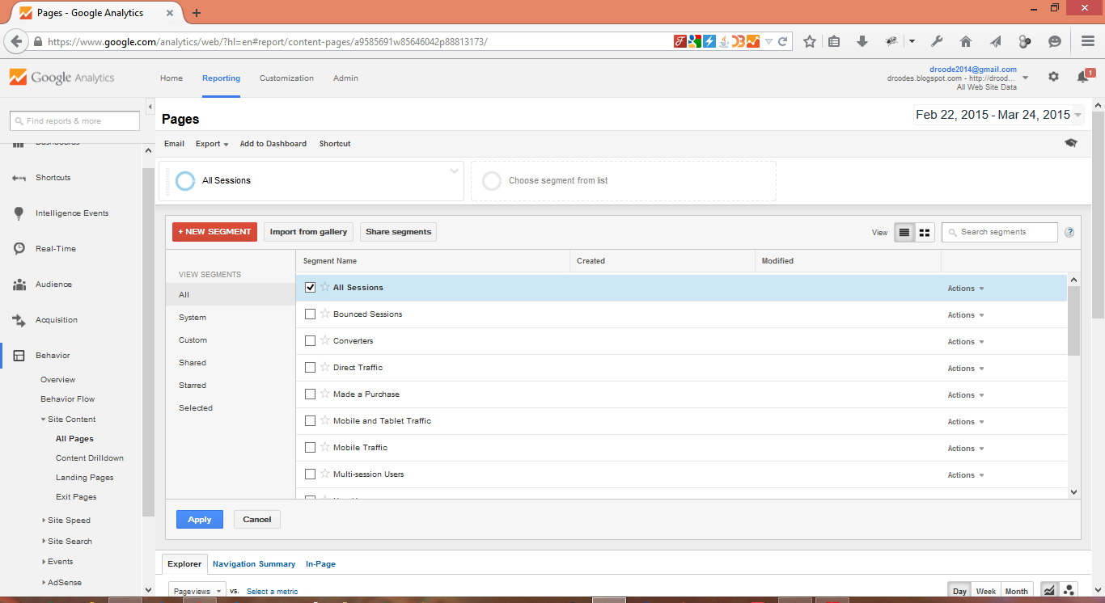
To pick from list of options on the right (scroll for more) and apply to added segment

Slide 36
To fully customize segment

Slide 37
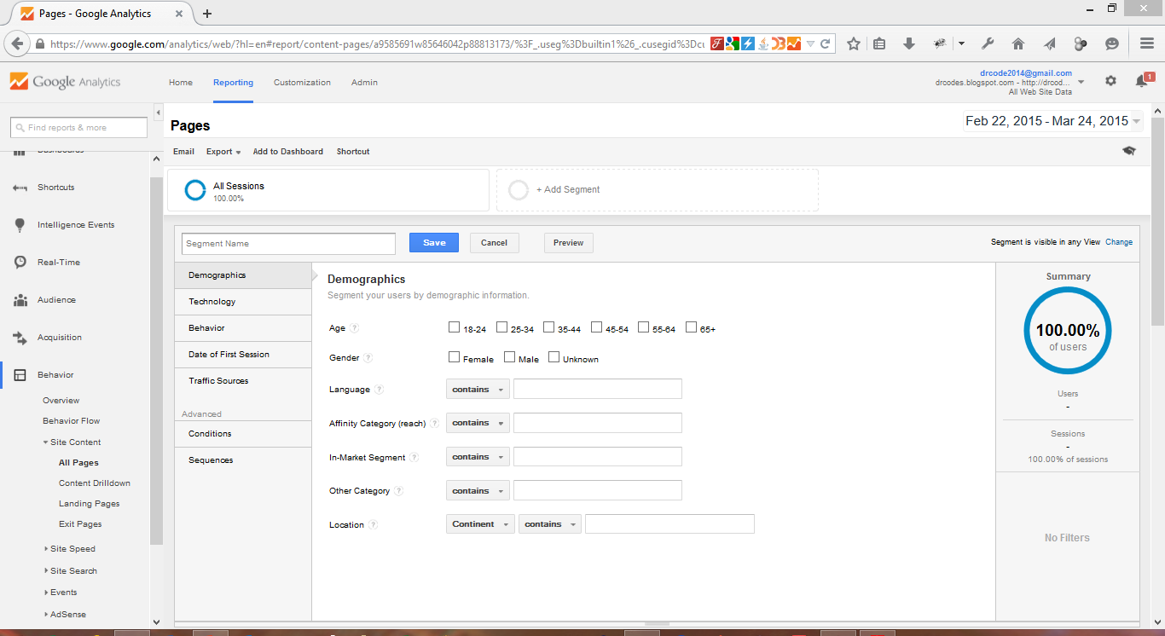

Slide 38
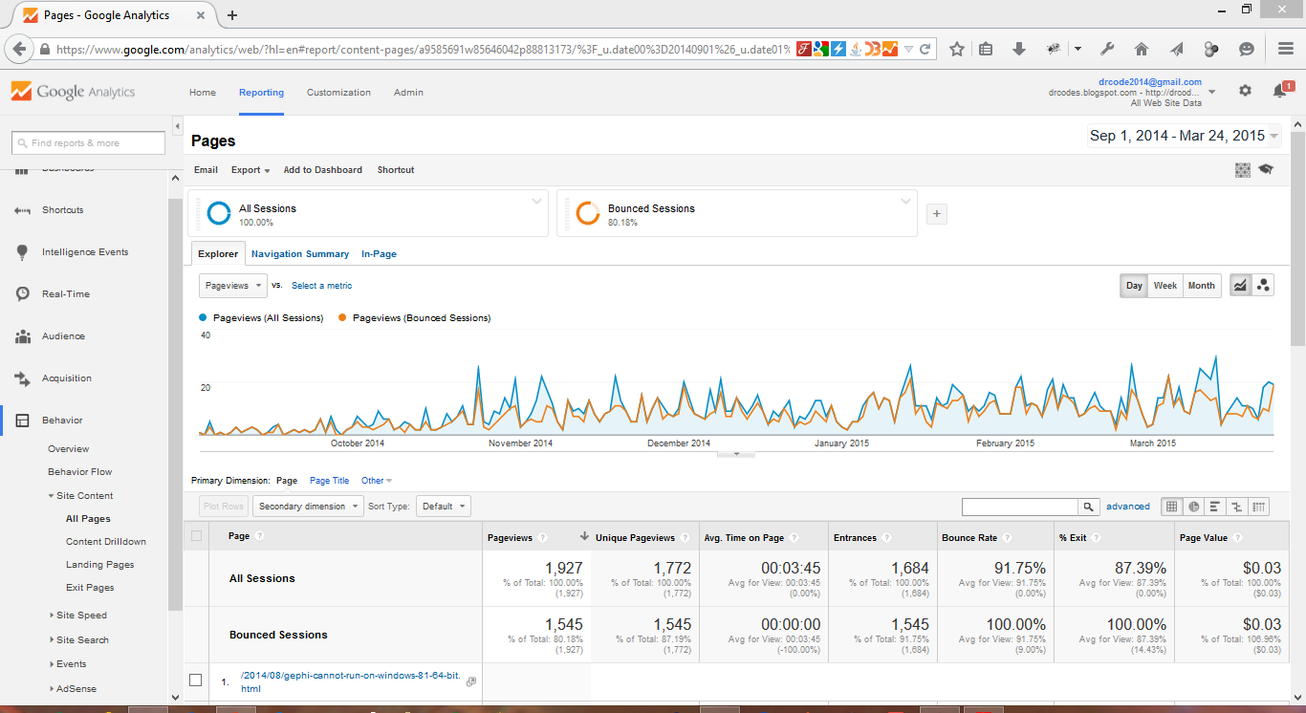

Slide 39
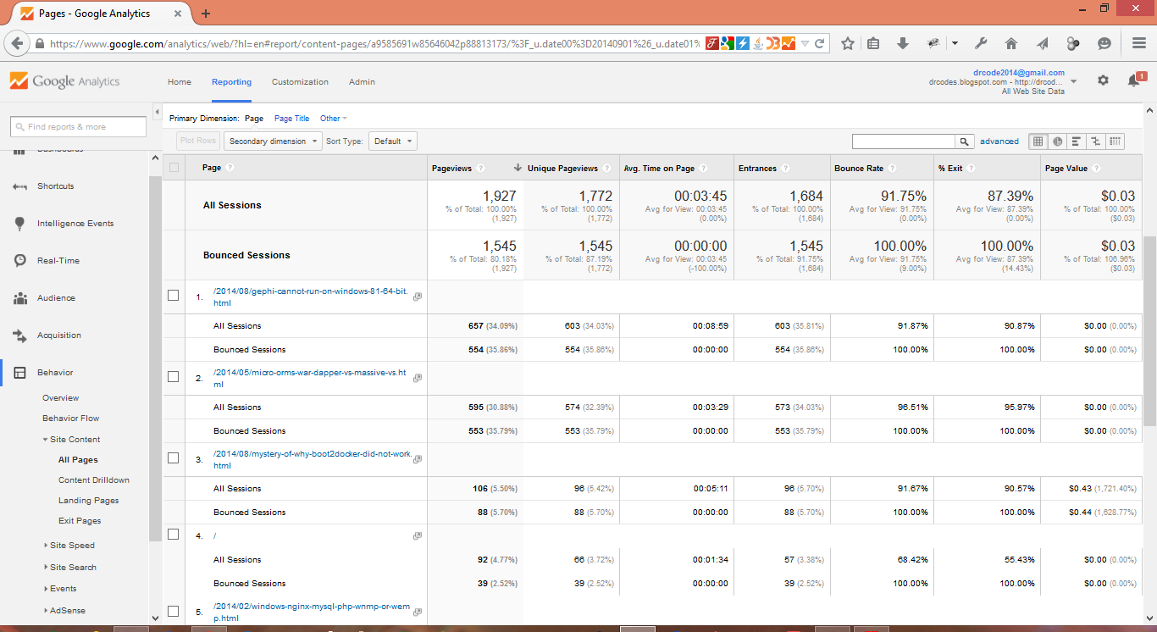
data is segmented or split

Slide 40
Conversion Optimization

Slide 41
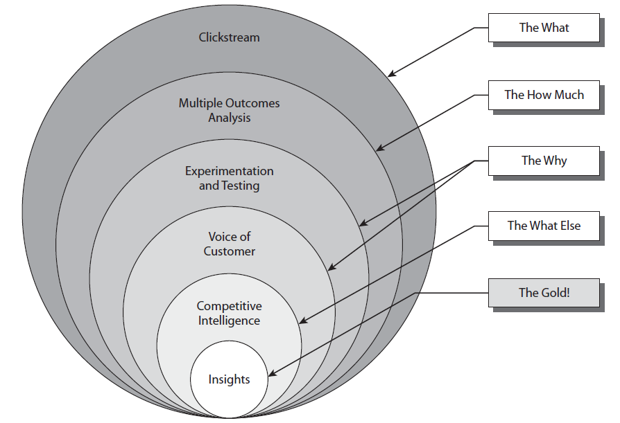
Key questions for WA
(source: Avinash K, Web Analytics 2.0)

Slide 42
Content Experiments
Quantitative methods:
Run Experiments Live On Your Site And Let Your Customers Show You What Works Best

Slide 43


Slide 44
A/B Testing
A/B Testing
A method of marketing testing by which a baseline control sample is compared to a variety of single-variable test samples in order to improve response or conversion rates.
Testing of more than one version of a web page:
Each version of the web page is usually uniquely created and stand-alone.
The goal is to try, for example, three versions of the home page or product page and see which version of the page works better - measuring one outcome.
Definition from Wikipedia
Definition from Avinash Kaushik

Slide 45
A/B Testing
How to measure?
Put up different versions of the same page with only one variable changed (e.g placement of image, color, font size ) and measure.
Pros
Using existing resources to measure:
We’ll be using Google Analytics Content Experiments(previously known as Google Website Optimizer).
Cons
Hard to control external factors (campaigns, search traffic, seasonality)
Adapted from http://www.kaushik.net/avinash/experimentation-and-testing-a-primer/

Slide 46
Multivariate Testing (multi-armed banding experiments)
Multivariate testing is a process by which more than one component of a website may be tested in a live environment.
Many A/B tests are performed on one page at the same time.
A/B tests are usually performed to determine the better of two content variations; multivariate testing can theoretically test the effectiveness of limitless combinations.
The only limits on the number of combinations and the number of variables in a multivariate test are the amount of time it will take to get a statistically valid sample of visitors and computational power.
Definition from Wikipedia

Slide 47
Google Analytics Content Experiments
http://www.youtube.com/watch?v=TGrujIh2H0I
Key Features:
Content Experiments is a somewhat different approach from either standard A/B or multivariate testing.
Content Experiments is more A/B/N.
You're not testing just two versions of a page as in A/B testing, and you're not testing various combinations of components on a single page as in multivariate testing.
Instead, you are testing up to five full versions of a single page, each delivered to visitors from a separate URL.
Adapted from https://support.google.com/analytics/bin/answer.py? hl=en&answer=1745147&topic=1745207&parent=1745146&rd=1

Slide 48
Content Experiments
With Content Experiments, you can:
Compare how different web pages perform using a random sample of your visitors.
Define what percentage of your visitors are included in the experiment.
Choose what type of goal you’d like to test.
Adapted from https://support.google.com/analytics/bin/answer.py? hl=en&answer=1745147&topic=1745207&parent=1745146&rd=1

Slide 49
Content Experiments
An example of using experiments to improve your business
You have a website where you sell house-cleaning services.
You offer basic cleaning, deep cleaning, and detailed cleaning.
Detailed cleaning is most profitable of the three, so you’re interested in getting more people to purchase this option.
Most visitors land on your homepage, so this is the first page that you want to use for testing.
Adapted from https://support.google.com/analytics/bin/answer.py?hl=en&answer=1745149

Slide 50
Content Experiments
For your experiment, you create several new versions of this web page:
One with a big red headline for detailed cleaning, one in which you expand on the benefits of detailed cleaning, and one where you put an icon next to the link to purchase detailed cleaning.
A random sample of your visitors see the different pages, including your original home page, and you simply wait to see which page gets the highest percentage of visitors to purchase the detailed cleaning.
When you see which page drives the most conversions, you can make that one the live page for all visitors.
Adapted from https://support.google.com/analytics/bin/answer.py?hl=en&answer=1745149

Slide 51
Content Experiments
Experiments require:
Different versions of your web pages to serve to your visitors.
Goals that have been defined in Google Analytics.
Each experiment page is measured according to the percentage of visitors who view the page and accomplish the goal.
Create different versions of your web pages to test:
Headlines and headers
Images and icons
Text
Calls to action
Page layout
Adapted from https://support.google.com/analytics/bin/answer.py?hl=en&answer=1745149

Slide 52
Content Experiments
You can use two kinds of Google Analytics goals:
URL Destination goals
An experiment that uses a URL Destination goal focuses on getting visitors to view a specific web page.
Use this kind of goal to find out things like how well your test page encourages visitors along a path to a product page, a page that includes the location of your business, or pages on which you're selling ads.
Event goals An experiment that uses an event goal focuses on getting visitors to perform a specific action on a page.
Use this kind of goal to find out things like how well your test page encourages visitors to sign up for a newsletter, view a video, or click Add to Cart for a product.
Adapted from https://support.google.com/analytics/bin/answer.py?hl=en&answer=1745149

Slide 53
Content Experiments
Testing Guidelines
Test only a few elements If you change multiple elements on each page, it can be difficult to figure out which element or combination of elements was responsible for the best results. For example, create multiple pages but change only the main image on each page, and keep the same layout and text to ensure that any difference between the page results is due to the image.
Use high-volume pages The more often that people visit a page or complete a goal, the less time it takes to gather data.
Make bold changes Visitors can miss small changes and you can end up with inconclusive results.
Keep testing With follow-up testing, you can build on the success of your experiment. Did one headline encourage a lot more purchases? If so, test it alongside a product image or an image of a spokesperson.
Adapted from https://support.google.com/analytics/bin/answer.py?hl=en&answer=1745149

Slide 54
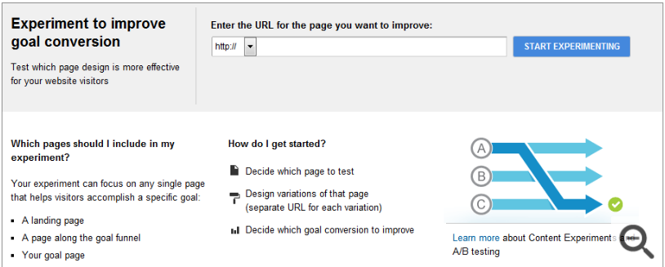
Content Experiments
Adapted from https://support.google.com/analytics/bin/answer.py? hl=en&answer=1745152&topic=1745207&ctx=topic

Slide 55
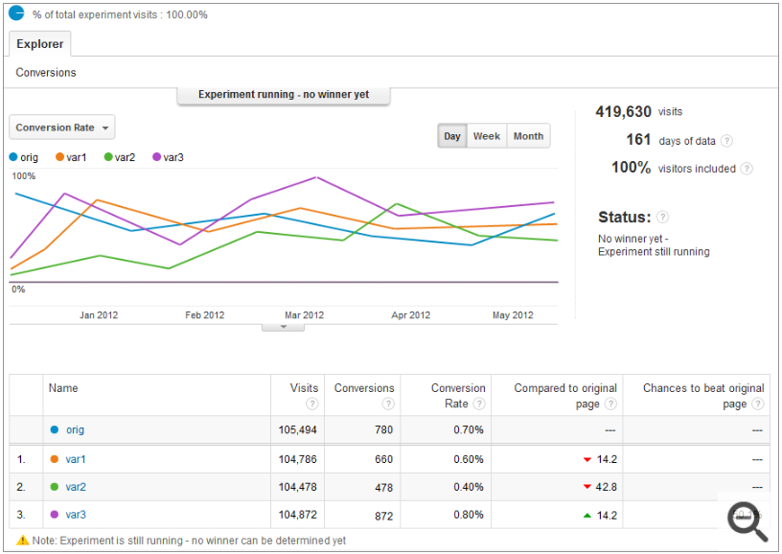
Content Experiments

Slide 56
Voice of Customer
Qualitative methods:
Getting Direct Feedback From Customers On Your Website Or From Target Customer Base

Slide 57


Slide 58
Voice of Customer
Answering the “WHY”
Direct feedback from the customers or target customer base
Through
Open text VOC surveys,
Lab usability studies
Adapted from
Web Analytics 2.0: The Art of Online Accountability and Science of Customer Centricity by Avinash Kaushik

Slide 59
Voice of Customer
Lab usability tests measure user’s ability to complete tasks using a website with each task defined a specific goal for effectiveness, efficiency and satisfaction in a given context of use.
Adapted from
Web Analytics 2.0: The Art of Online Accountability and Science of Customer Centricity by Avinash Kaushik

Slide 60
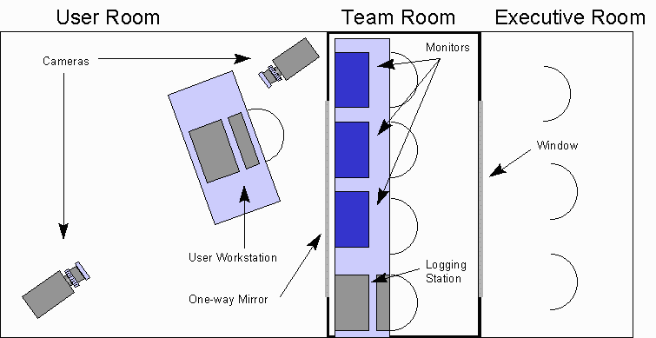
Usability Lab

Slide 61

Usability Lab

Slide 62
Voice of Customer
Surveys:
Page-level surveys.
Site-level surveys.
Adapted from
Web Analytics 2.0: The Art of Online Accountability and Science of Customer Centricity by Avinash Kaushik

Slide 63

Page-level survey
Adapted from
Web Analytics 2.0: The Art of Online Accountability and Science of Customer Centricity by Avinash Kaushik

Slide 64
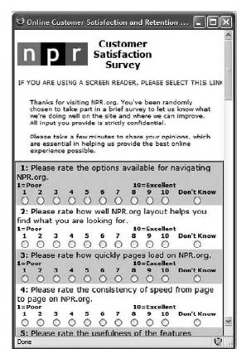
Site-level survey
Adapted from
Web Analytics 2.0: The Art of Online Accountability and Science of Customer Centricity by Avinash Kaushik

Slide 65
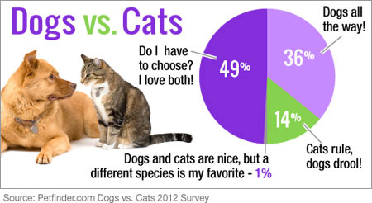

Slide 66
Traffic Analysis
Learning how users got to your web site

